Slide 1
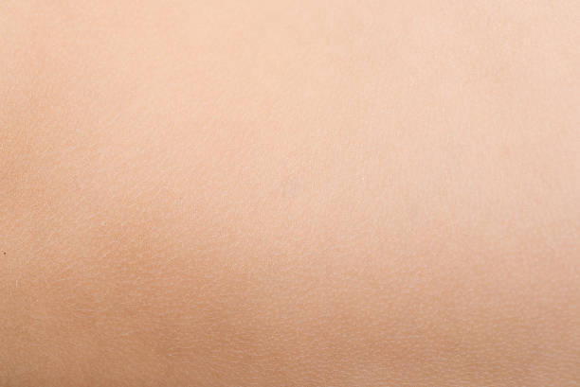
Ultrasonics:
Skin Analysis
Kyra Bednarski James Brown Hunter LaGrassa Mary McNeil Kyle Sheptika

Slide 2
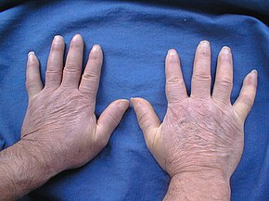
Motivation
Skin problems are among the most common diseases seen in Primary Care settings
disfigurement, disability, or symptoms such as intractable itch reduces the quality of life
Lack of Non-Invasive Analysis Tools
Need to generate quantitative results to show patient's risk level for certain skin diseases
Notes:
Mary

Slide 3
Objectives
Market Research
Skin Mechanics
Video Tracking
Skin Disease
Dermatologists
Existing Companies
Consumers
Non-linear interactions between layers
Deformation
Shear
Information in Ultrasound
Constitutive Model Actual to Digital
User-Interface
Correlate Analysis to Skin Mechanics of various diseases
Minimize Dermatologist Interaction with Analysis
Notes:
Hunter

Slide 4
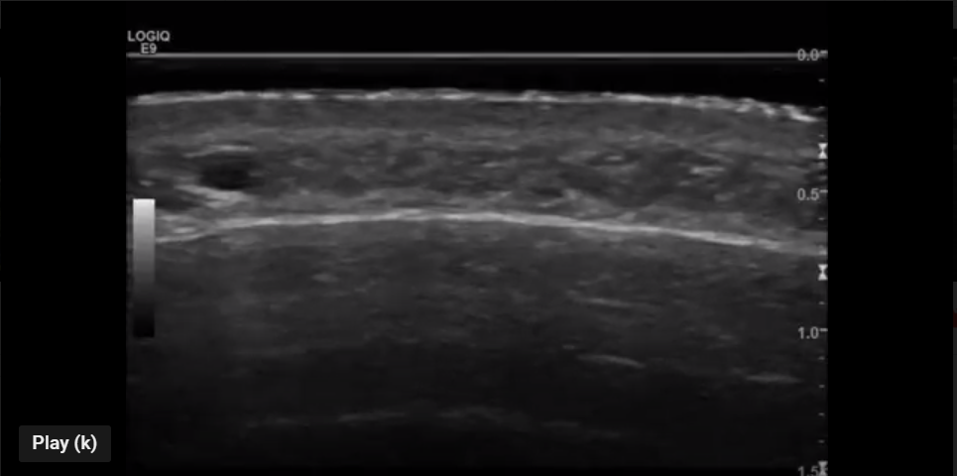
Major Issues
Gaining familiarity with the mechanical properties of skin
Coordinating video-based tracking data
Meeting with dermatologists
Notes:
Kyra

Slide 5
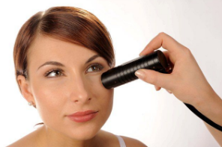
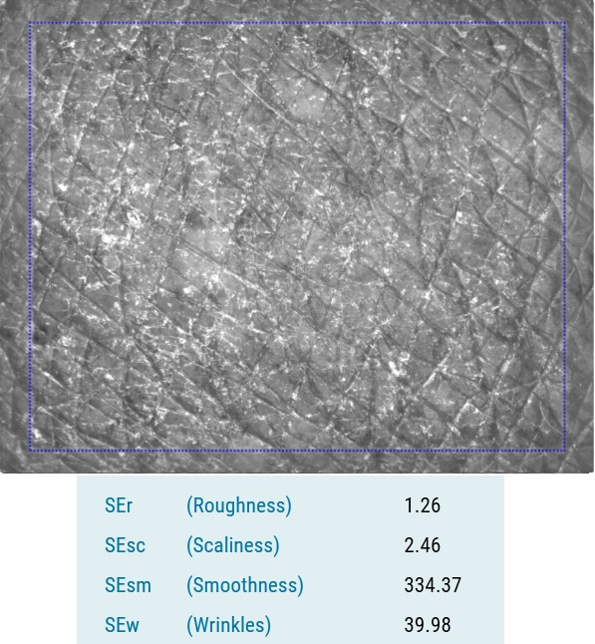
Courage and Khazaka Cutometer
Benefits
Disadvantages
Recognized as the standard in cosmetology
Non-Invasive
Self-Administered
Real-Time Analysis
Obtains viscoelastic and elastic skin properties
Optical measuring system lacks deep skin layer resolution
Not embedded with analysis software linking skin disease
Notes:
Hunter

Slide 6
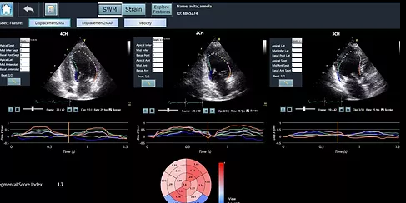
DiA Machine Learning Ultrasound Analysis
Benefits
Accessible to clinicians with various levels of experience
Automatic Quantitative Analysis
Removes Subjectivity and decreases error
analyze cardiac ultrasound images
Notes:
Hunter

Slide 7
DiA Ultrasound Analysis (Contd)
Disadvantages
No skin analysis software implementation
Lack of research focusing on the mechanical properties of the skin
Potential Opportunity
Collaborate with DiA
reduce the busy work of designing the UI elements
allow our team to focus on researching skin mechanics
Difficulty of Learning DiA platform
Easier to develop software from scratch
Drawbacks of Partnership
Notes:
Hunter

Slide 8
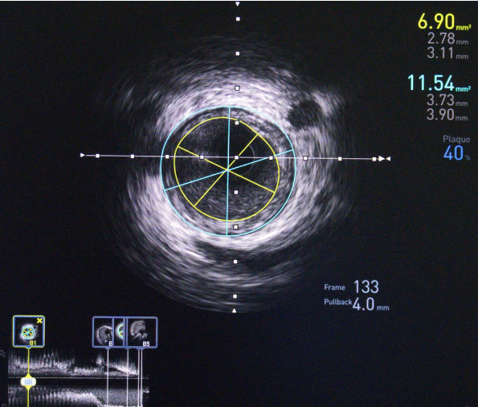
RSIP Vision: Intravenous Ultrasound
Benefits
Disadvantages
Improves low-resolution Intravenous Ultrasounds
analysis of 3D images
Applied to wide selection of Ultrasound Imaging Tools
linked live surgeries analysis to clinical treatments
lack focus on analysis of skin mechanical properties
not accessible to clinicians with various levels of experience
Opportunity
Cater to medical professionals
Insight into Design of UI
Analyze Severe Diseases
Notes:
Hunter

Slide 9
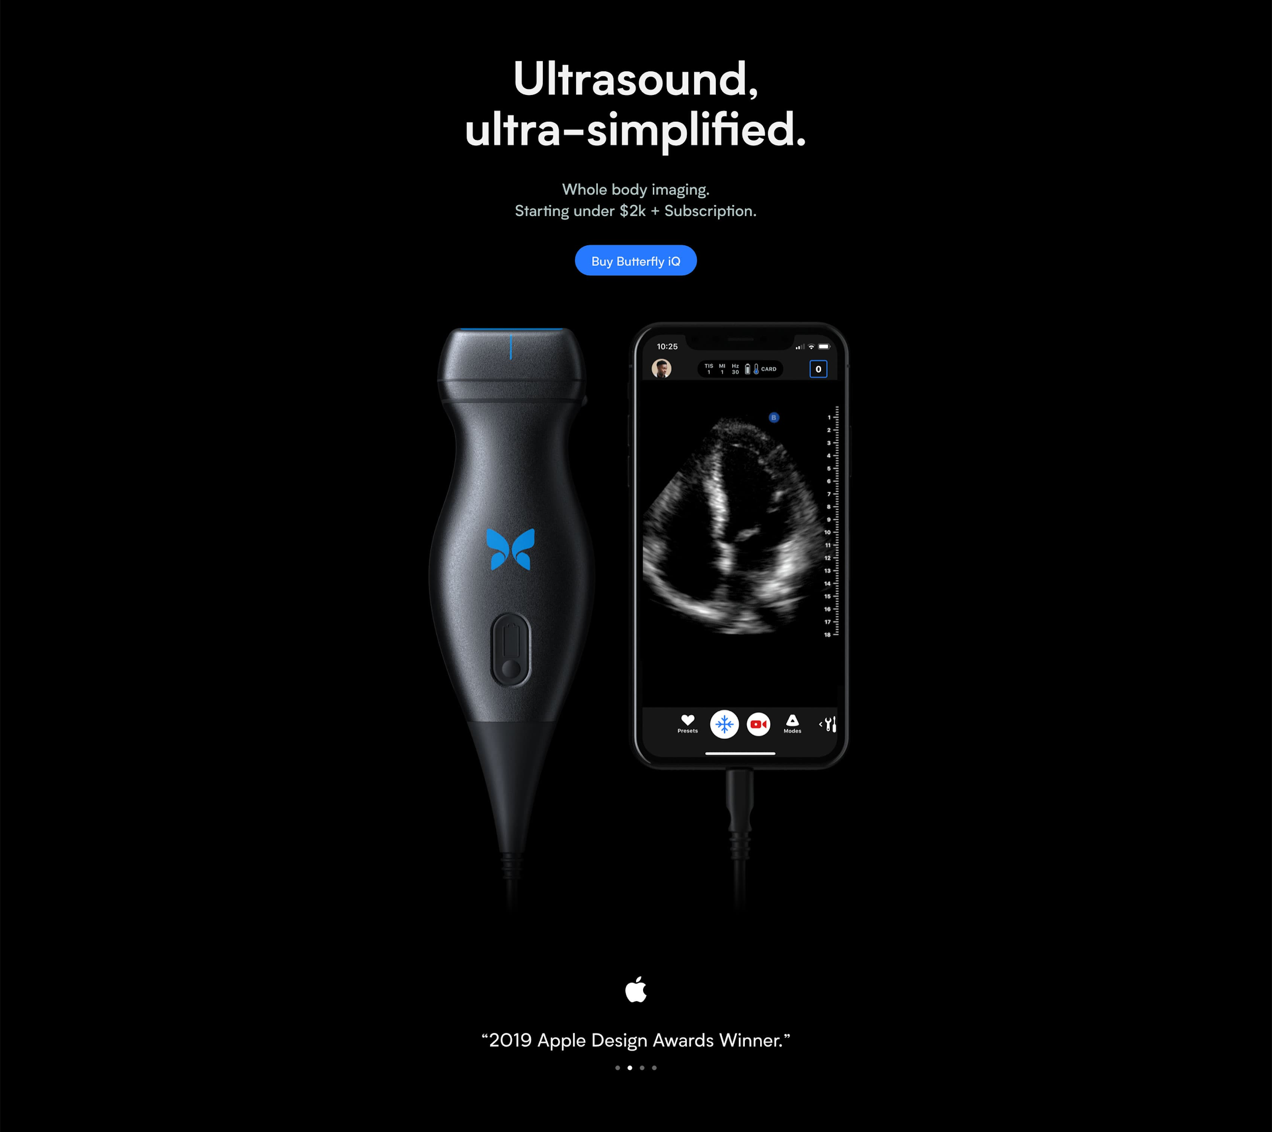
Butterfly Network: Portable ultrasound machine
“Two-thirds of the world’s population has no access to medical imaging” - Dr. Jonathan Rotherberg, Founder of Butterfly Network
Butterfly Network believes Doctors lack time to
conduct in-depth analysis
keep up with current knowledge
Interpret new studies and clinical treatments
Butterfly iQ seeks to empower doctors with personalized precise medical analysis tools to compensate for their limited time and knowledge base
Notes:
Hunter

Slide 10
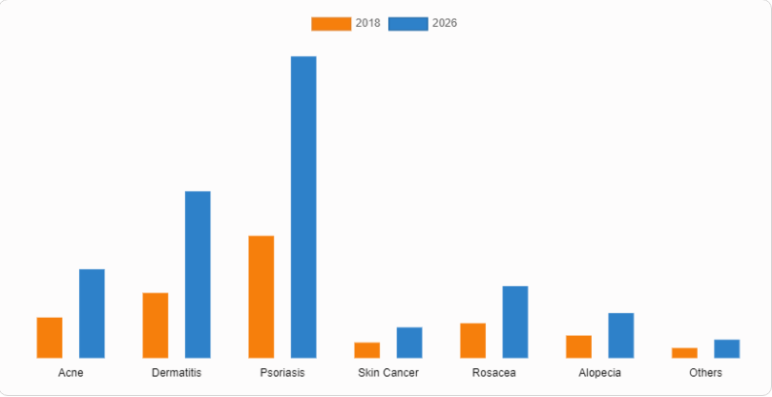


Commercial Applications
Dermatologists are not the primary beneficiary,
they are the primary intended software user.
Cater the UI design towards dermatologists
Dermatological Market
Major Growth Factors
Demand for topological drugs
awareness about skin diseases
demand for rapid diagnosis
Psoriasis
Skin Cancer
Acne
Mukhekar, Sagar. “Dermatologicals Market by Dermatological Disease.” Allied Market Research, alliedmarketresearch.com/dermatolgical-drugs-market.
Notes:
Hunter

Slide 11
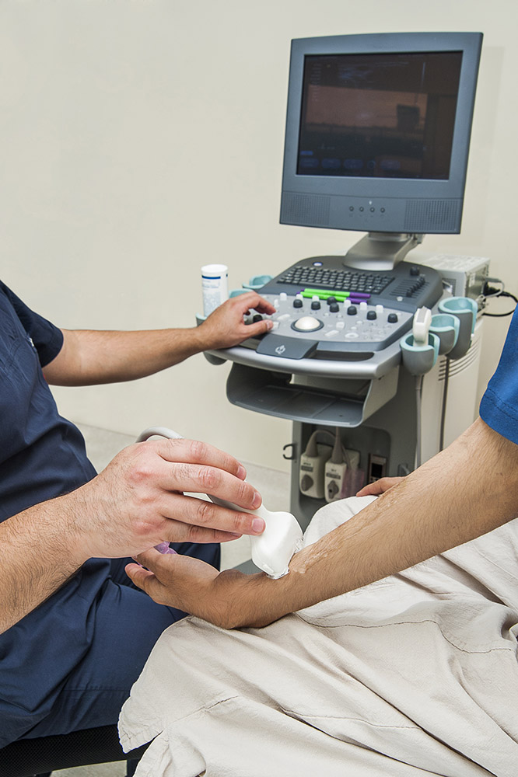
Needs and Specifications
Quantify results of skin analysis
Monitor and track skin deformations/diseases
Differentiate between layers of skin and how each deforms
Used within dermatologists office
Notes:
Kyra

Slide 12
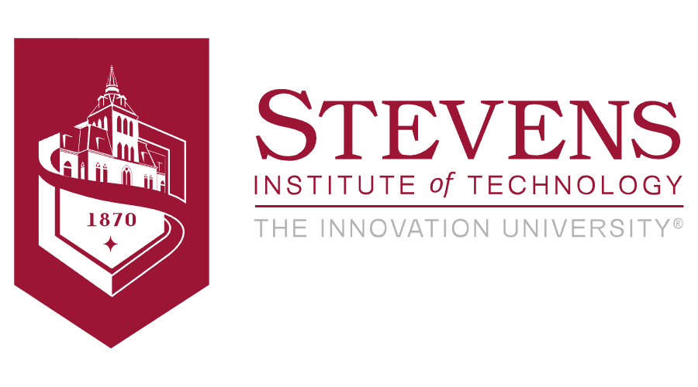
Stakeholders
Primary
Stevens Mechanical Engineering Department
Team
Advisor - Johannes Weickenmeier
Secondary
Dermatologists
Patients with skin conditions
Legal organizations
Agency for Healthcare Research and Quality
Notes:
Kyra

Slide 13
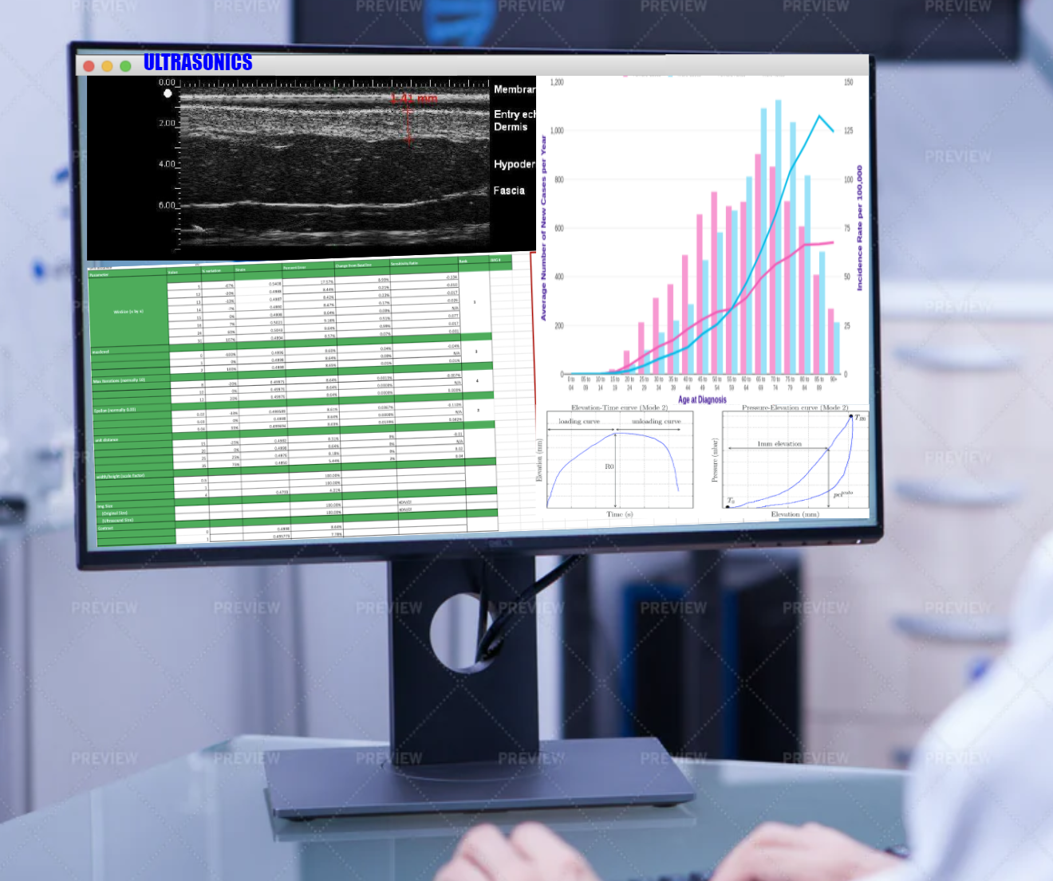
Concept Generation and Selection
Video-based tracking is being utilized to obtain information on skin conditions with deformations
Technology utilizes ultrasound/lab recorded video to quantitatively track and assess the deformations
Product is intended to be used by a certain demographic; those who can interpret the information
User Interface for patients has to be developed as they are the ones being affected by the conditions; ideally mobile app
Notes:
Mary

Slide 14
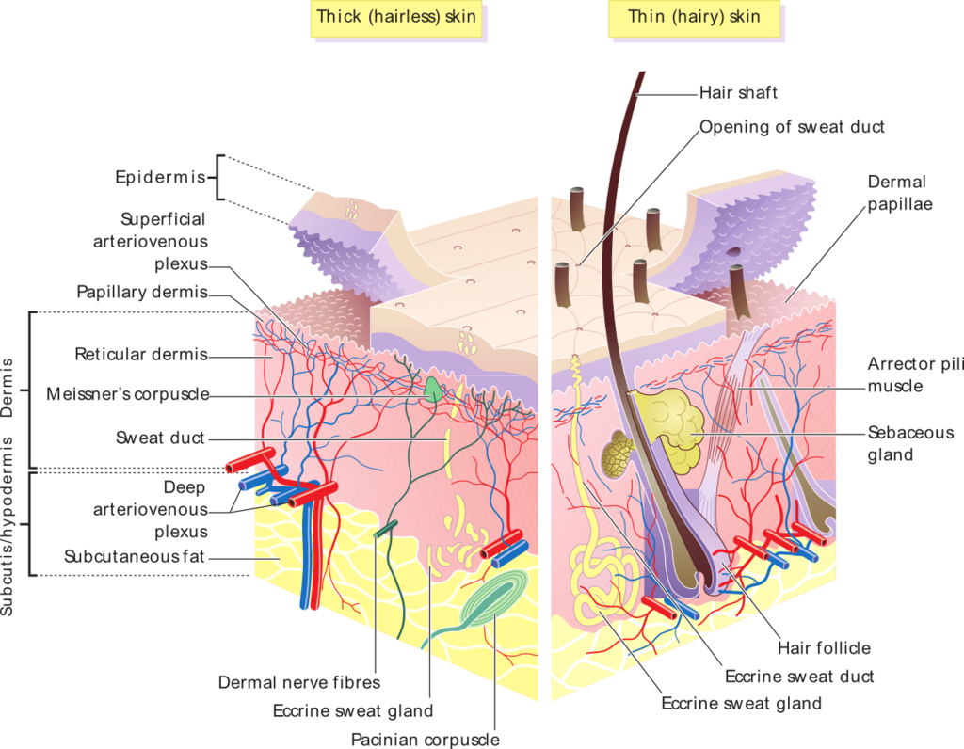
Technical Analysis
Skin Anatomy
The epidermis is the outermost layer
Cell generation
Microstructure
Deformation
Strain/Shear
Stiffness
Notes:
Travis

Slide 15
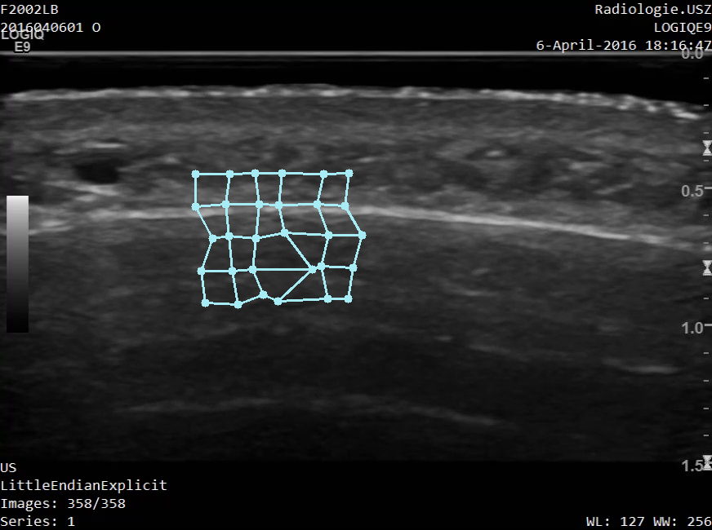
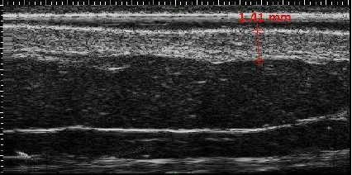
Technical Analysis
Ultrasound Images
Inhibited accuracy of UltraSound
Resolution of picture
Quality of video
Notes:
Xd nevermind
Ok

Slide 16
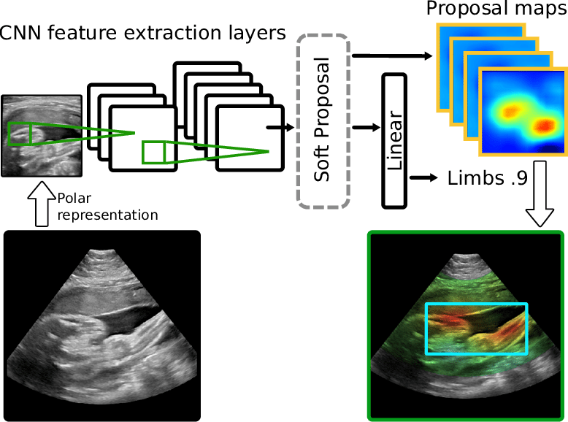
Technical Analysis
Convolutional Neural Network
Computer Vision Algorithm for Ultrasound Video
classify the deformation
skin thickness
shear
time-dependent properties of skin
Generate Synthetic Training Data
Error Function
Compare Predictions to Training Data
Notes:
Hunter

Slide 17
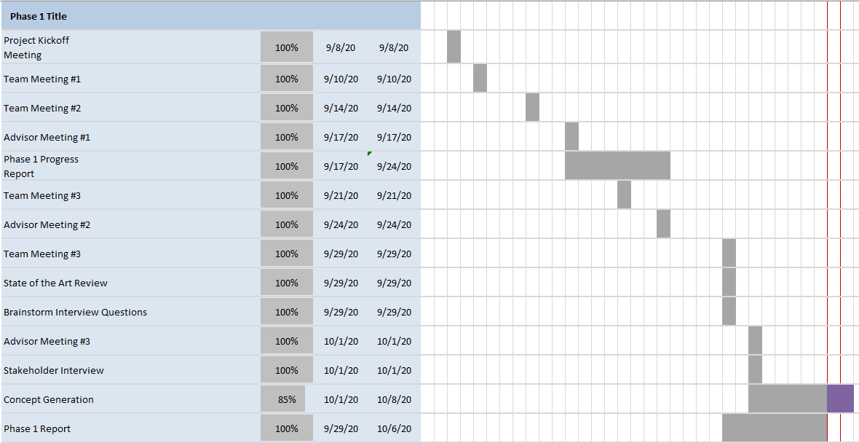
Project Plan - Gantt Chart
Notes:
Kyra

Slide 18
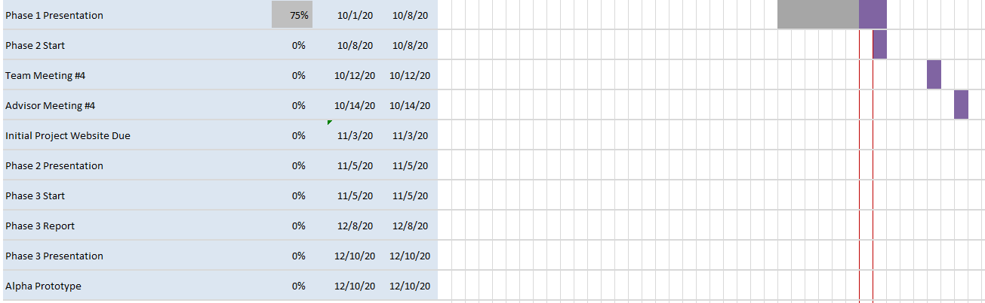
Gantt cont.
Notes:
Kyra

Slide 19
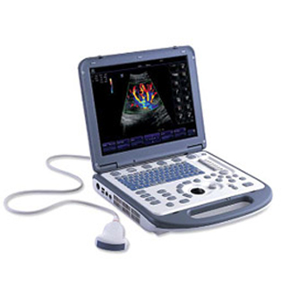
Budget
Soft Tissue Samples
Portable Ultrasound Machine
Clinical Data (Ultrasound Images)
Notes:
Kyra

Slide 20
Conclusions
There exists Powerful Ultrasound Analysis technology
Mechanical properties of soft tissues can teach us a lot about diseases
Still much more research to be done, But the Team is Confident
Current Objectives
Correlate skin deformations and skin diseases
Reach out to dermatologists for insight
Determine Market Segment
Notes:
Mary

Slide 21
References
AI Ultrasound Solutions. DiA Imaging Analysis. https://www.dia-analysis.com/lvivosolutions.
Accessed 29 September 2020.
AI for Endoscopy. RSIP Vision. https://www.rsipvision.com/endoscopy/. Accessed 29 September
2020.
Butterfly iQ Butterfly Network. https://store.butterflynetwork.com/us/en/. Accessed 29
September 2020.
Efficacy Skin Tests. Courage and Khazaka.
courage-khazaka.de/en/scientific-products/efficacy-tests/skin. Accessed 2 October 2020.
Mukhekar, Sagar. “Dermatologicals Market by Dermatological Disease.” Allied Market Research,
alliedmarketresearch.com/dermatolgical-drugs-market. Accessed 6 October 2020.
“Skin Conditions by the Numbers.”American Academy of Dermatology, January 2020,
aad.org/media/stats-numbers. Accessed 5 October 2020.
“Ultrasound.” National Institute of Biomedical Imaging and Bioengineering, July 2016.
https://www.nibib.nih.gov/science-education/science-topics/ultrasound. Accessed 29 September 2020.

Slide 22
Questions?

